Slide 1


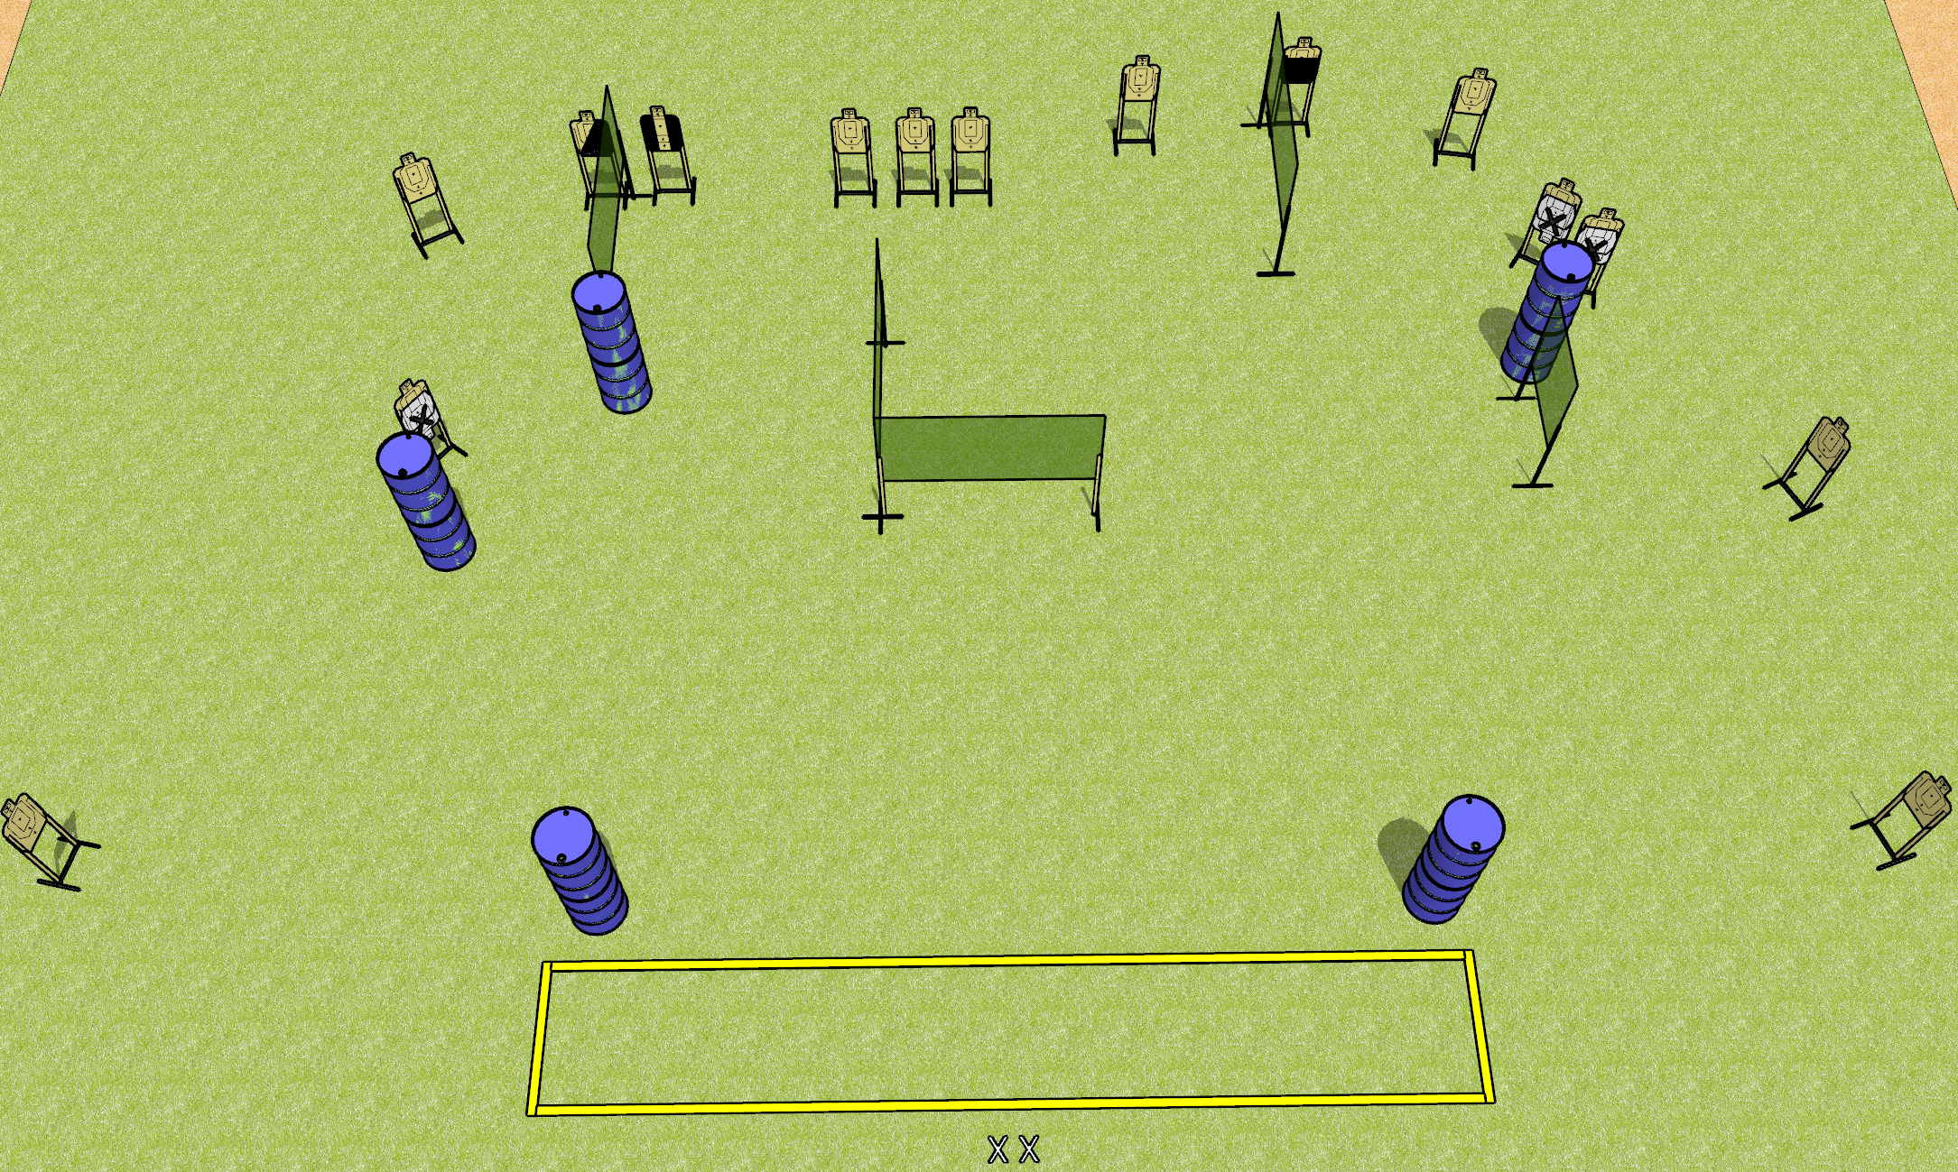
 | Dothan Gun Club – USPSA Match No Fun Course Designer : Drew Coleman
Round Count 30 rounds 15 USPSA
Equipment List 9 wall feet 2 medium fault lines 1 tux, 1 left diag, 1 50%

Slide 2
No Fun
Written Stage Briefing
No Fun is a 30 round, 150 point, Comstock course of fire. There are 15 USPSA targets. The best 2 hits will score.
Handgun start position is feet on X’s, wrists below belt. Handgun is loaded and holstered.
PCC start position is feet on X’s, stock on belt. Loaded carbine is held with both hands, safety on.
On the audible start signal, engage targets as they become available from within the shooting area.

